Slide 1




Roundtable introduction
WELCOME!
@EcoCommonsAus
Species Distribution Modelling in R
Step 4: Model evaluation
Dr Rob Clemens (he/him)
Change & Communications E: comms@ecocommons.org.au
T: @EcoCommonsAus
@RobertSClemens1
Notes:
Welcome to the workshop: Using the BCCVL to solve environmental problems, brought to you by the EcoCommons program
Firstly, as we gather for this workshop dispersed across many physical locations, I would like to take a moment to acknowledge the various traditional owners of the lands on which we meet, including the the Traditional Custodians of the ACT, the Ngunnawal people where I am today. I acknowledge the Elders – past, present and emerging of all the lands that we work and live on, and recognise their extraordinary contributions to the cultural, economic and scientific domains that we will discuss today.

Slide 2
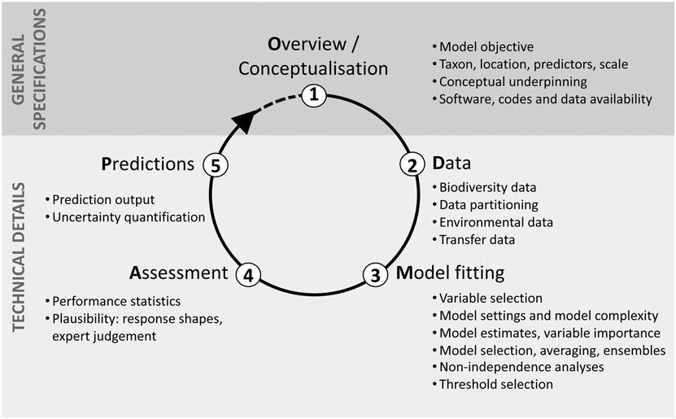
Overview of the process
Zurell, et. al.(2020), A standard protocol for reporting species distribution models. Ecography, 43: 1261-1277. https://doi.org/10.1111/ecog.04960

Slide 3

Model evaluation
Notes:
There is a variety of different outputs that your species distribution model will produce that you can use to draw conclusions about the distribution of your species.
You can check the predictive performance of the model with a whole bunch of so-called evaluation statistics. But before you look at the stats, it is always good to
to do a reality check of the visual outputs such as the predicted distribution map and the response curves of the environmental variables.
Let’s have a look at those first.

Slide 4
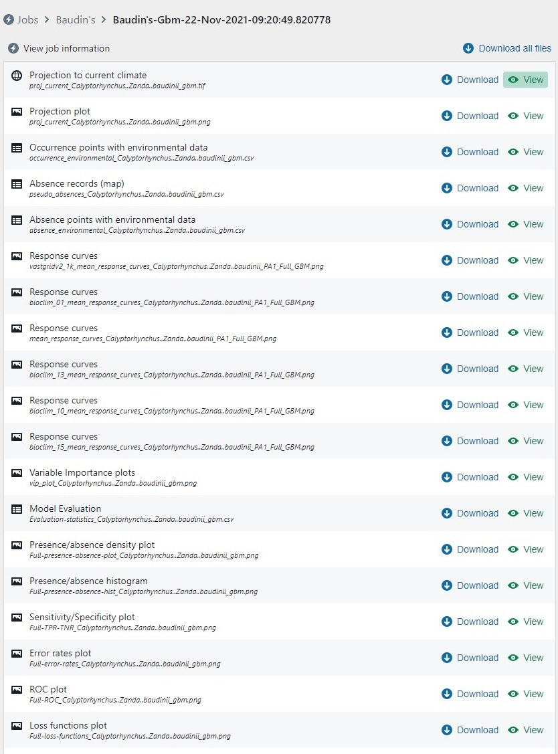
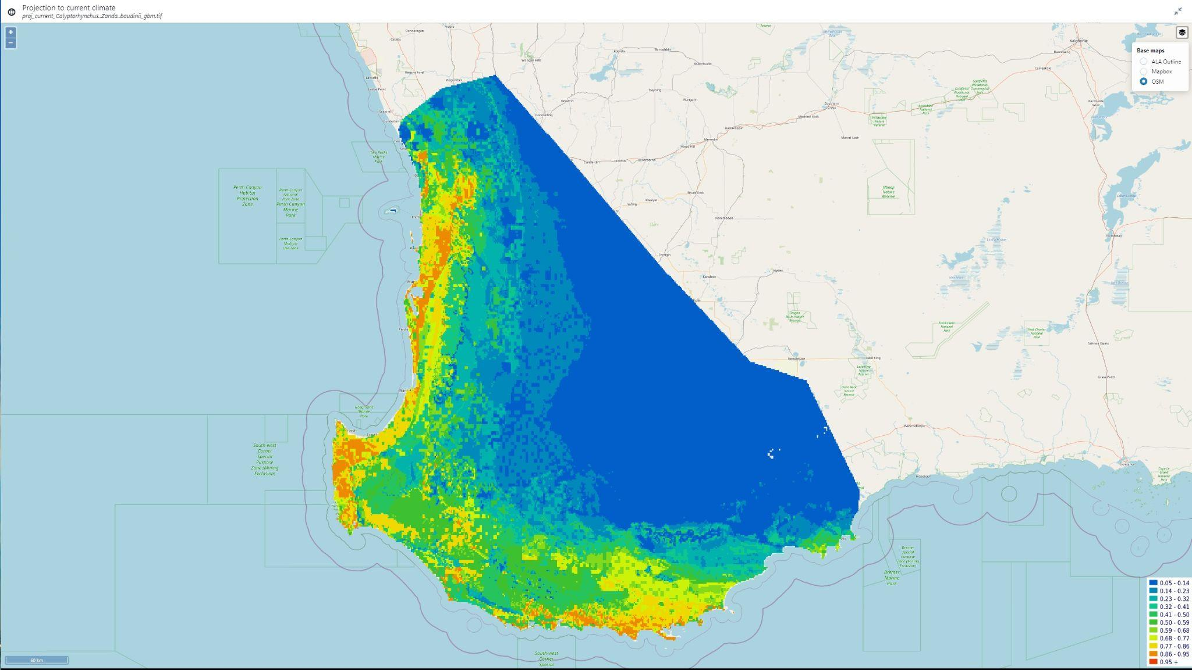
Predicted species distribution
Reality check:
☐
Are mapped predictions plausible?
☐
Consider dispersal barriers
Notes:
The bccvl provides a couple of results that allow you to inspect the distribution. For example you can view the distribution within a set study area- this can be things like protected areas, states, ecoregions
Or you can view the unconstrained area which predicts the distribution within the environmental envelope.

Slide 5
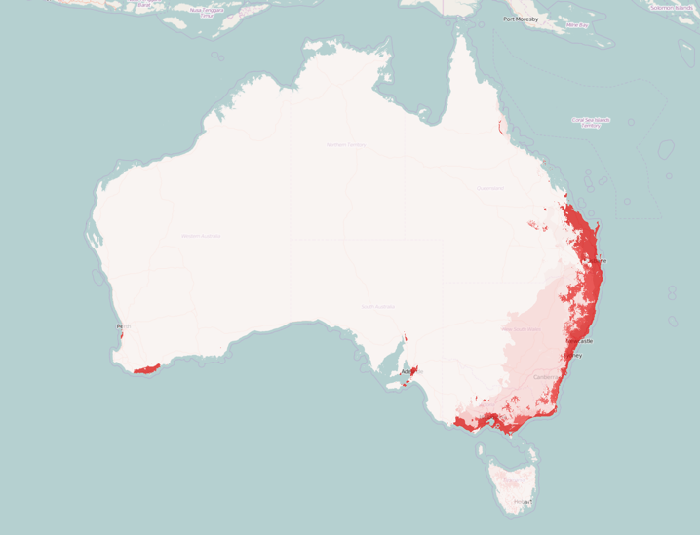
Threshold selection
Probability of presence (continuous)
Categorical prediction: present/absent
1 (high)
Maximise the sum of sensitivity plus specificity often works best
Present
0.5
threshold
Absent
0 (low)
Notes:
Most algorithms produce this probability score as a continuous response ranging from 0, which represents low probability of presence to 1, which refers to a high probability of presence.
To calculate the evaluation statistics, these probabilistic predictions (C) are commonly converted to a categorical prediction, which means that for any given point it is predicted whether a species could be present or absent.
This conversion is based on (C) a threshold value of the probability prediction.
By convention, this threshold is often set at (C) 0.5, which means that for each location with a probability above 0.5, (C) the prediction is positive, thus the species is present, and locations with a probability below 0.5 (C) are predicted to be negative, thus the species is absent.
However, there are a lot of different methods for selecting the threshold value depending on factors such as the overall error pattern of the model and the ratio of presence vs absence points.

Slide 6
Evaluation statistics: ROC curve
Predictive performance: ROC curve
Results: Evaluation stats – Relative Operating Characteristic (ROC)
Confusion Matrix
perfect prediction
Predicted
1
Negative Positive
True Negative (TN) | False Positive (FP)
False Negative (FN) | True Positive (TP)
Random prediction
Actual
Positive Negative
True Positive Rate
better
AUC = area under the curve
0.5-0.7 = poor model performance
0.7-0.9 = moderate
> 0.9 = excellent
True Positive Rate (TPR) = TP/(TP + FN)
False Positive Rate (FPR) = FP/(FP + TN)
worse
0
0
1
False Positive Rate
Notes:
A commonly used evaluation criterion is the Relative Operating Characteristic, or ROC plot, which uses two of the criteria that I just explained.
The ROC plot is a graph with the False Positive Rate on the x-axis and the True Positive Rate on the y-axis.
A perfect model would result in predictions with no false positives and no false negatives (point on coordinate 0,1 in figure), with a curve that looks like this.
A random guess would result in a point along the diagonal line from the left bottom to the right corner. This is the divider of the ROC space. Any point above the line represents predictions that are better than random, whereas points below the line represent poor predictions.
The value for ROC is the area under the curve (AUC), and is calculated by summing the area under the ROC curve.
A value of 0.5 represents a random prediction, and values above 0.5 indicate predictions better than random.
The closer the ROC curve follows the y-axis, the larger the area under the curve, and thus the more accurate the model. In general, AUC values of 0.5–0.7 are considered low and represent poor model performance, 0.7–0.9 are considered moderate, and values above 0.9 represent excellent model performance.

Slide 7
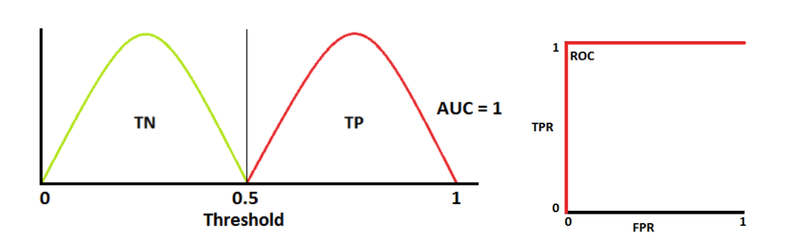
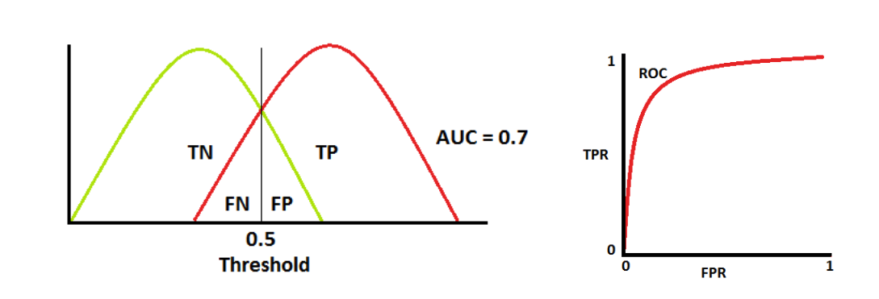
Evaluation statistics: ROC curve
Predictive performance: ROC curve
Results: Evaluation stats – Relative Operating Characteristic (ROC)
Source:
https://towardsdatascience.com/understanding-auc-roc-curve-68b2303cc9c5
Notes:
A commonly used evaluation criterion is the Relative Operating Characteristic, or ROC plot, which uses two of the criteria that I just explained.
The ROC plot is a graph with the False Positive Rate on the x-axis and the True Positive Rate on the y-axis.
A perfect model would result in predictions with no false positives and no false negatives (point on coordinate 0,1 in figure), with a curve that looks like this.
A random guess would result in a point along the diagonal line from the left bottom to the right corner. This is the divider of the ROC space. Any point above the line represents predictions that are better than random, whereas points below the line represent poor predictions.
The value for ROC is the area under the curve (AUC), and is calculated by summing the area under the ROC curve.
A value of 0.5 represents a random prediction, and values above 0.5 indicate predictions better than random.
The closer the ROC curve follows the y-axis, the larger the area under the curve, and thus the more accurate the model. In general, AUC values of 0.5–0.7 are considered low and represent poor model performance, 0.7–0.9 are considered moderate, and values above 0.9 represent excellent model performance.

Slide 8
Predictive performance
True Skills Statistic
TSS > 0.9 = Superior (TPR+TNR-1)
TPR = TP/(TP + FN)
TNR = TN/(TN + FP)
TSS
Kappa
TNR
Odds ratio
ROC
ETS
FAR
FNR
Bias score
FPR
F1 score > 0.9 excellent
F1 = 2*((Precision*Recall)/(Precision+Recall))
Precision <- TP / (TP + FP)
Recall <- TP / (TP + FN)
NPP
TPR
Accuracy
MCR
A suite of evaluation statistics
More here: https://towardsdatascience.com/the-f1-score-bec2bbc38aa6
Notes:
As I just said you can also check the performance of your model with a whole bunch of statistics. Some of these might ring a bell, others probably not. I won’t go into the detail of these, as you can find lots of information on our support page. I will show you one commonly used evaluation technique...

Slide 9
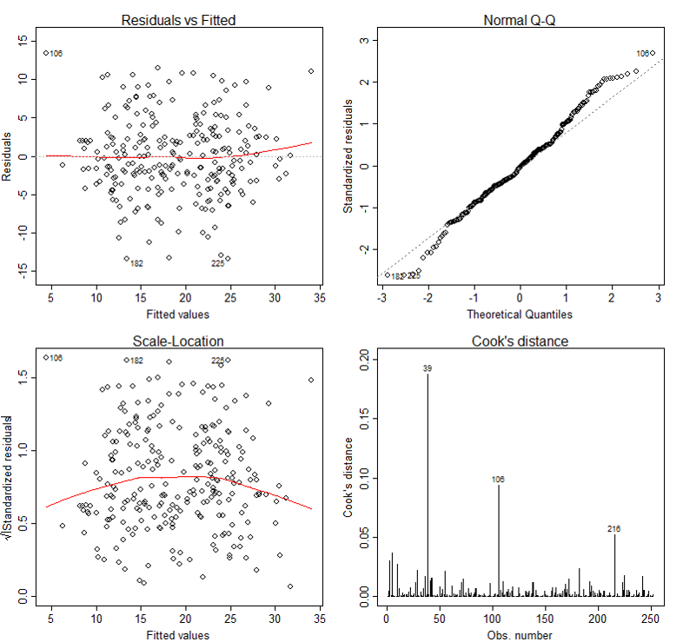
Statistics framework highlights relationships between variables really well
IF assumptions are met!
Also, more developed for tough distributions (zero-inflated, negative binomial)
Geographic models
Statistical
models
https://sphweb.bumc.bu.edu/otlt/MPH-Modules/BS/R/R5_Correlation-Regression/R5_Correlation-Regression7.html

Slide 10
Predictive performance?
Independent data assessment
Partitioned test data
Cross-validation
Bootstrapping
Training data sensitivity and specificity
Best
Worst

Slide 11

Step 4: Model evaluation
How to get a threshold to use
How to generate a confusion matrix for training data
Generate evaluation statistics from confusion matrix for training data
Get independent data
Repeat with independent data
Notes:
However, if you look up a distribution map of a species, it often shows a range rather than dots on a map. So, how do we go from specific places where individuals of a species have been observed to producing a map that gives an estimate of the distribution of that species? This is where species distribution models come into play.

Slide 12
Step 4: Model evaluation
LiPe_mod_new <- gbm.step(data = LiPe_preds3, gbm.x = brt_drops$pred.list[[2]], gbm.y = 3, family = "bernoulli", tree.complexity = 3, learning.rate = 0.01, bag.fraction = 0.75)
xy.sp_1s<-SpatialPoints(xy_1s)
xy.sp_0s<-SpatialPoints(xy_0s)
LiPe_preds_brt_new <- LiPe_predictors[[which(c(TRUE,TRUE,TRUE,TRUE,FALSE,FALSE))]]
brt_pred <- predict(LiPe_preds_brt_new,LiPe_mod_new,type="link") # note we usually use type link, but the evaluate function is based on the "link" scale
brt_eval_training <- dismo::evaluate(xy.sp_1s, xy.sp_0s, LiPe_mod_new, LiPe_preds_brt_new)
Notes:
However, if you look up a distribution map of a species, it often shows a range rather than dots on a map. So, how do we go from specific places where individuals of a species have been observed to producing a map that gives an estimate of the distribution of that species? This is where species distribution models come into play.

Slide 13
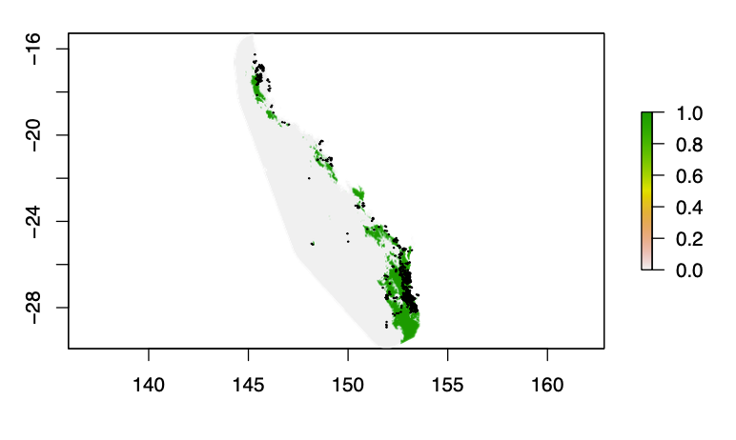
Step 4: Model evaluation
thresh_brt <- threshold(brt_eval_training,stat = "kappa")
thresh_brt2 <- threshold(brt_eval_training,stat = "spec_sens")
m <- c(-5, thresh_brt, 0, thresh_brt, 2.1, 1)
reclass <- matrix(m, ncol= 3, byrow= TRUE)
rc_brt <- reclassify(brt_pred, reclass)
plot(rc_brt)
brt_eval_training
x_s<- LiPe_preds3$Long
y_s<-LiPe_preds3$Lat
xy.sp_s<-SpatialPoints(xy_s)
predicted <- raster::extract(rc_brt,xy.sp_s)
Notes:
However, if you look up a distribution map of a species, it often shows a range rather than dots on a map. So, how do we go from specific places where individuals of a species have been observed to producing a map that gives an estimate of the distribution of that species? This is where species distribution models come into play.

Slide 14
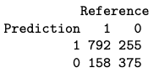
Step 4: Model evaluation
test1 <- as.data.frame(cbind(predicted = predicted, reference = LiPe_preds3$pres))
test1$reference <- factor(test1$reference, levels = c("1","0"))
test1$predicted <- factor(test1$predicted, levels = c("1","0"))
conf_matrix <- confusionMatrix(test1$predicted,test1$reference)
conf_matrix$table
TP <- conf_matrix$table[1,1]
FP <- conf_matrix$table[1,2]
FN <- conf_matrix$table[2,1]
TN <- conf_matrix$table[2,2]
FPR <- FP/(FP + TN)
FNR <- FN/(FN + TP)
TPR <- TP/(TP + FN)
TNR <- TN/(TN + FP)
Notes:
However, if you look up a distribution map of a species, it often shows a range rather than dots on a map. So, how do we go from specific places where individuals of a species have been observed to producing a map that gives an estimate of the distribution of that species? This is where species distribution models come into play.

Slide 15
Step 4: Model evaluation
TSS <- TPR + TNR - 1
Precision <- TP / (TP + FP)
Recall <- TP / (TP + FN)
F1 <- (2*Precision*Recall)/(Precision+Recall)
# or #
F1 <- TP /(TP + 0.5*(FP + FN))
Training data: F1 = 0.79; TSS = 0.43
Independent data: F1 = 0.79; TSS = 0.43
Notes:
However, if you look up a distribution map of a species, it often shows a range rather than dots on a map. So, how do we go from specific places where individuals of a species have been observed to producing a map that gives an estimate of the distribution of that species? This is where species distribution models come into play.

Slide 16
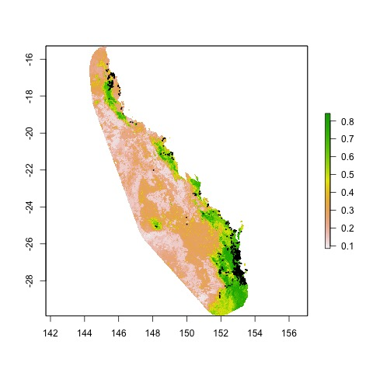
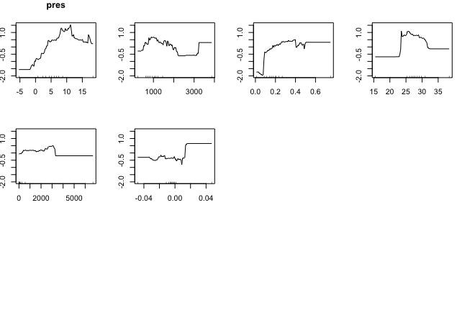
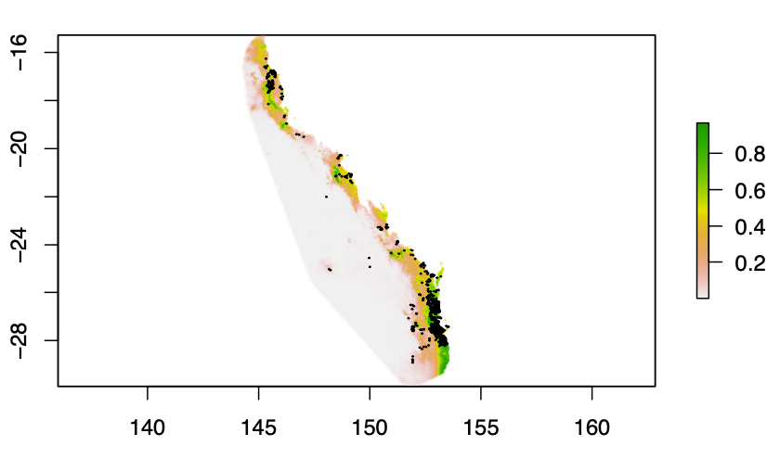
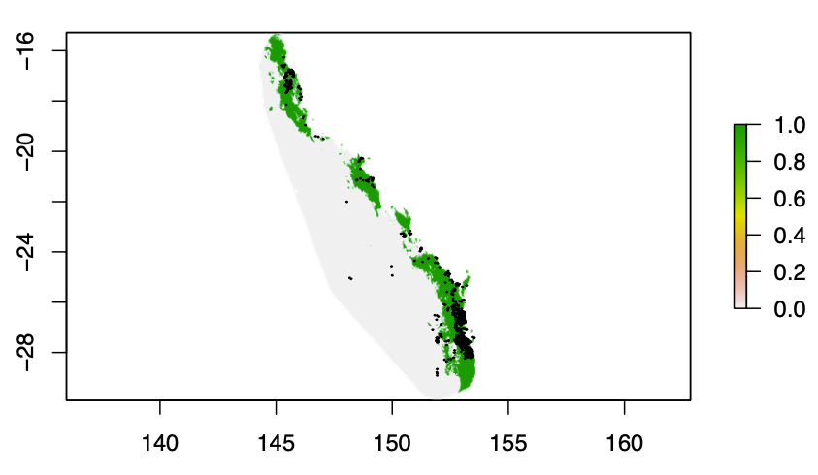
Step 4: Model evaluation
Notes:
However, if you look up a distribution map of a species, it often shows a range rather than dots on a map. So, how do we go from specific places where individuals of a species have been observed to producing a map that gives an estimate of the distribution of that species? This is where species distribution models come into play.

Slide 17

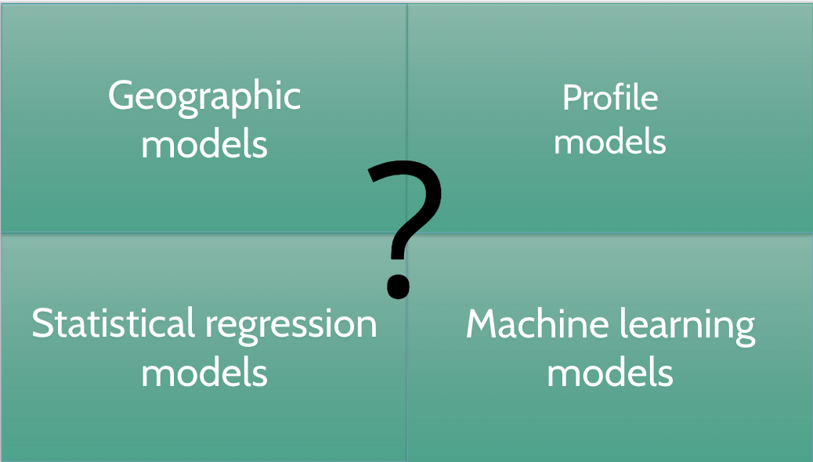
https://doi.org/10.1111/ecog.04890
Hao, T., Elith, J., Lahoz‐Monfort, J. J., & Guillera‐Arroita, G. (2020). Testing whether ensemble modelling is advantageous for maximising predictive performance of species distribution models. Ecography, 43(4), 549-558.

Slide 18
Does available data match your question?
Systematic sampling with same method in each locations, a well defined sampling protocol and zeros are recorded when a species is not detected.
Structured monitoring where zeros and sampling effort can be inferred
Unstructured monitoring where zeros and possibly sampling effort can be inferred
Opportunistic data where method and sampling are largely unknown
Best
Worst

Slide 19

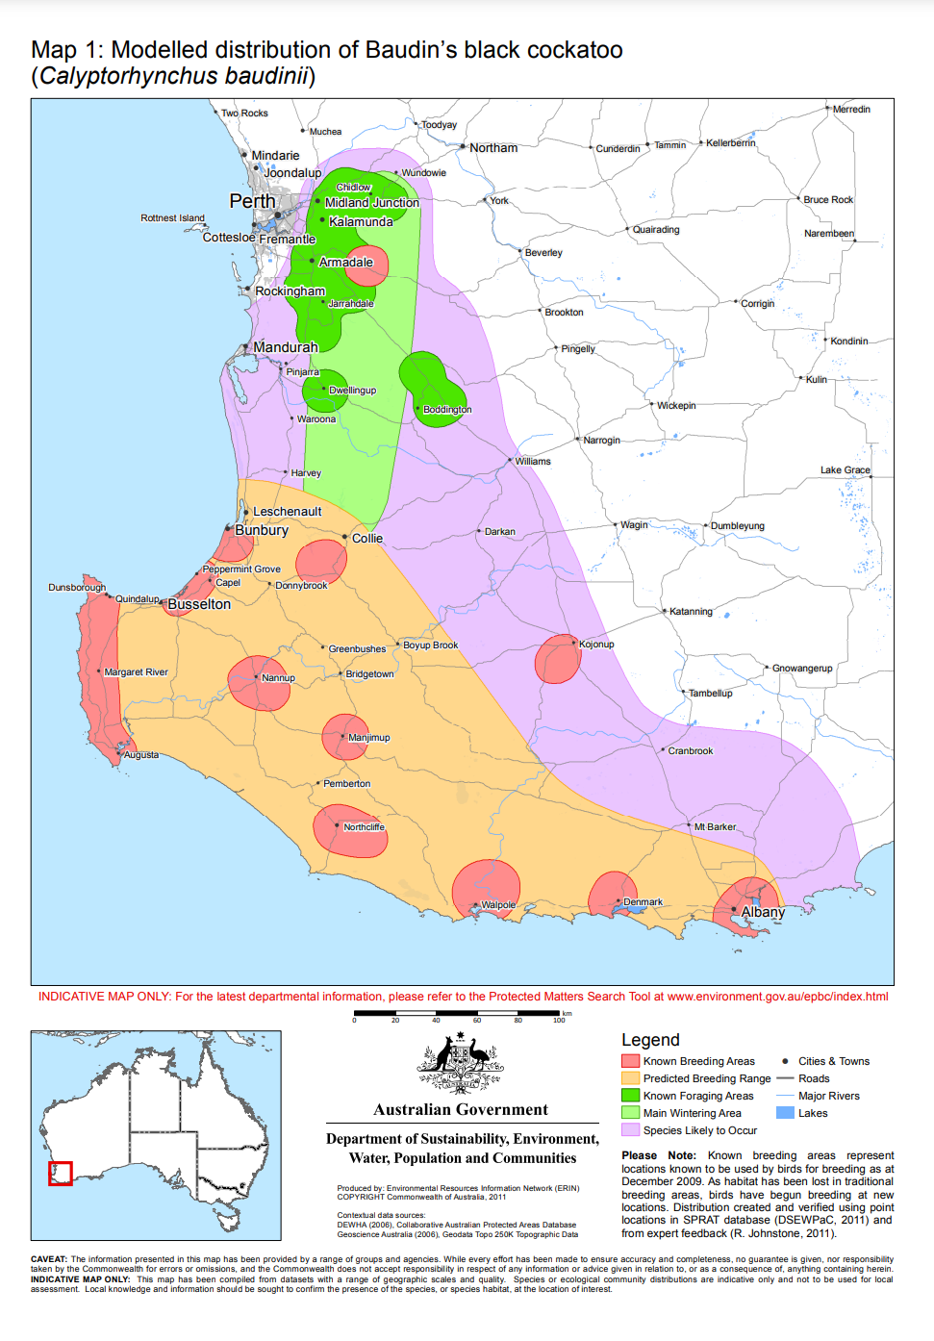
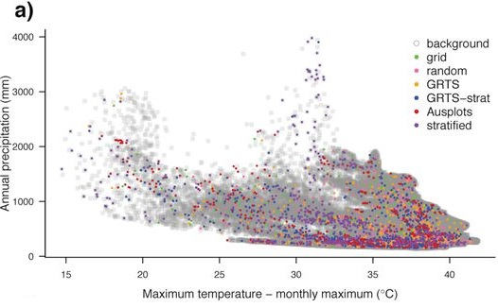
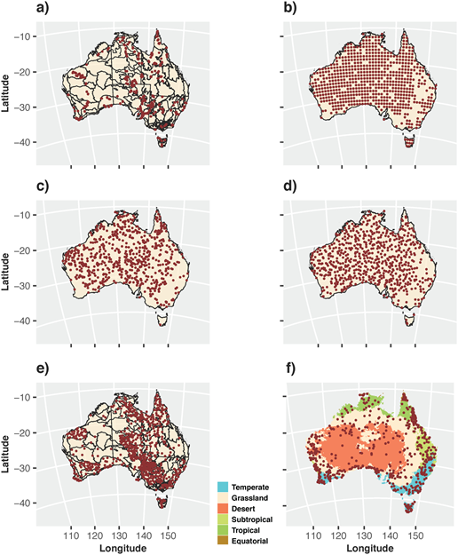
Visualisation of uncertainty
Lots of data from many sources
Coming soon!
Community modelling / GDM
Baudin’s Black Cockatoo (probability of occurrence)

Slide 20
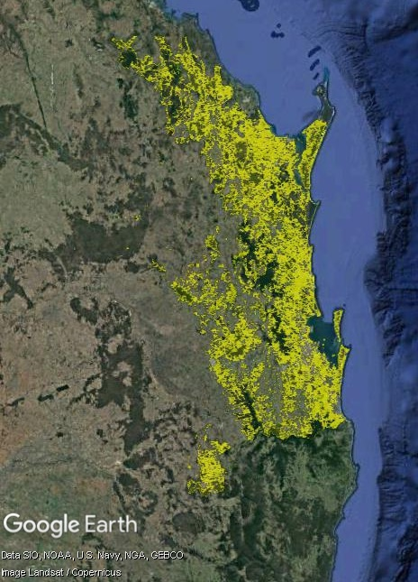
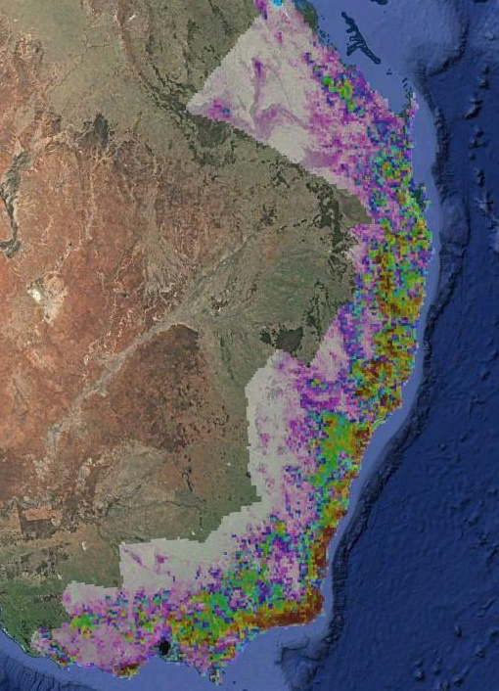
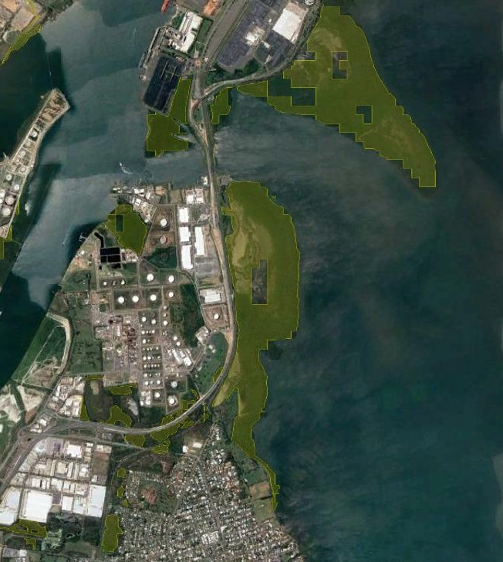
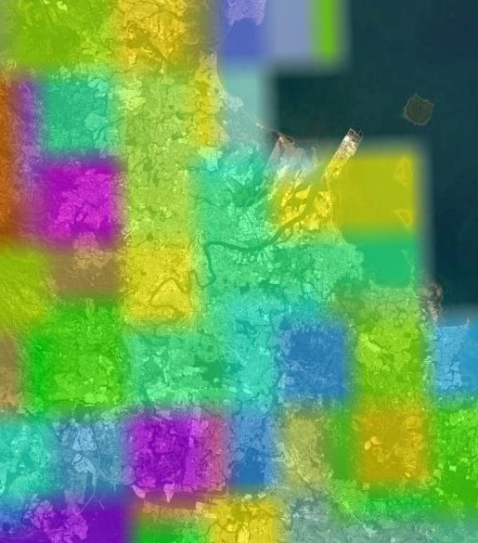
Who is your audience?
Don’t give your audience results that can be used at a scale they were not intended.

Slide 21

We would welcome your feedback
To learn basics of R coding
https://datacarpentry.org/R-ecology-lesson/
Press feedback button to tell us what changes you want & to highlight anything that is not working.
https://www.ecocommons.org.au/
Use Cases
Educational Material
Notes:
You can find out more about EcoCommons on our webpage: ecocommons.org.au.
To raise awareness of the current extinction crisis, we launched our webpage on Threatened Species Day which remembers the extinction of the Tasmanian tiger (Thylacinus cynocephalus) in 1936. EcoCommons is committed to help researchers and policy-decision makers stop further extinctions by empowering them with data and analytics to do better informed management of Australia’s 1900+ threatened species.
On our webpage you can find out:
How you can become an EcoCommons Pioneer and be the first to explore and test new tools!
Follow our journey - sign up for our newsletter
Follow us on twitter or LinkedIn: @EcoCommonsAus
Collaborate with us!

Slide 22

Explore EcoCommons webpage
Follow our Journey
https://www.ecocommons.org.au/
Notes:
You can find out more about EcoCommons on our webpage: ecocommons.org.au.
To raise awareness of the current extinction crisis, we launched our webpage on Threatened Species Day which remembers the extinction of the Tasmanian tiger (Thylacinus cynocephalus) in 1936. EcoCommons is committed to help researchers and policy-decision makers stop further extinctions by empowering them with data and analytics to do better informed management of Australia’s 1900+ threatened species.
On our webpage you can find out:
How you can become an EcoCommons Pioneer and be the first to explore and test new tools!
Follow our journey - sign up for our newsletter
Follow us on twitter or LinkedIn: @EcoCommonsAus
Collaborate with us!

Slide 23


We gratefully acknowledge:

Slide 24



Thank You

